Slide 1
Microsoft Azure Administration | Development
Modul 1 – Microsoft Azure| Einrichten der Entwicklungsumgebung

Slide 2
Inhalte
Einführung
01
Visual Studio
03
Lab IDE.1
04
Visual Studio Code
02

Slide 3
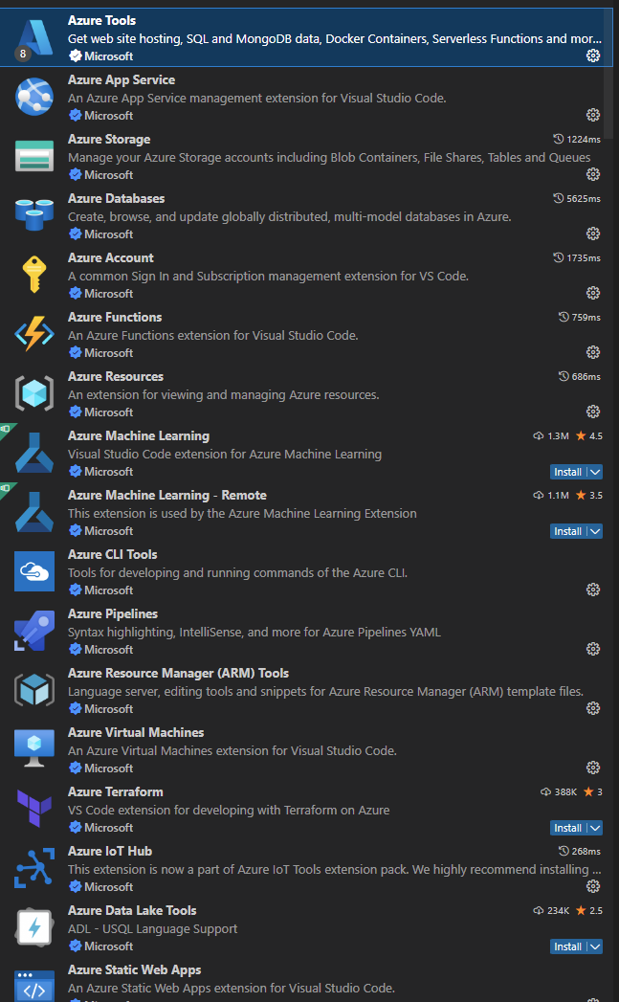
Visual Studio Code
Download unter https://code.visualstudio.com
Unter LINUX – Debian/Ubuntu
Download .deb (https://go.microsoft.com/fwlink/?LinkID=760868)
sudo dpkg –i <.deb>
sudo apt-get install –f
VSCode – Azure Extensions
Ideal: “AZURE TOOLS” = Extension Package

Slide 4
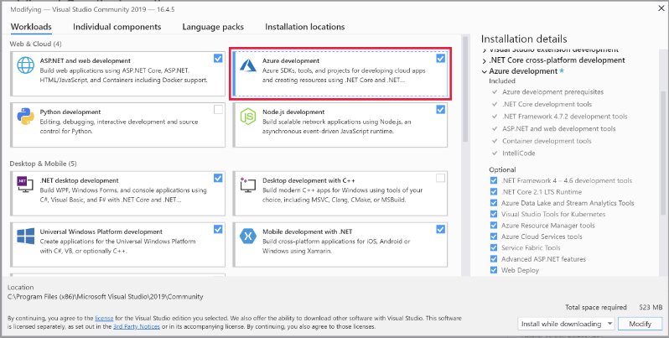
Visual Studio
Download https://visualstudio.microsoft.com/downloads/
Installation
Workloads – Azure development

Slide 5
DEMO: Azure Extensions in VSCode

Slide 6
Weitere Tools

Slide 7
Azure Storage Emulator – Azurite Azure Functions Core Tools (Local Debug) Azure Storage Explorer Static Web Apps CLI (Local Debug) …

Slide 8
Fragen?

